Slide 1
Java Arrays

Slide 2
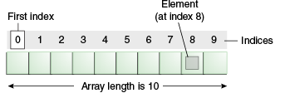
Java Arrays
an array is a collection of similar type of elements having contiguous memory location.
It is index-based, the first element of the array is stored at the 0th index, 2nd element is stored on 1st index and so on.
we can get the length of the array using the length member.
array is an object of a dynamically generated class. Java array inherits the Object class
we can also create single dimensional or multidimensional arrays in Java.
We can get any data located at an index position but can store only the fixed size of elements

Slide 3
Syntax to Declare Array
Single Dimensional Array
dataType[] arr; (or)
dataType []arr; (or)
dataType arr[];
Multidimensional Array
dataType[][] arrayRefVar; (or)
dataType [][]arrayRefVar; (or)
dataType arrayRefVar[][]; (or)
dataType []arrayRefVar[];

Slide 4
to declare, instantiate, initialize and traverse the array.
class Testarray{
public static void main(String args[]){
int a[]=new int[5];//declaration and instantiation
a[0]=10;//initialization
a[1]=20;
a[2]=70;
a[3]=40;
a[4]=50;
for(int i=0;i<a.length;i++) //length is the property of array
System.out.println(a[i]);
}}
//10 20 70 40 50

Slide 5
declaration, instantiation and initialization of array in a single line
class Testarray1{
public static void main(String args[]){
int a[]={33,3,4,5};//declaration, instantiation and initialization
//printing array
for(int i=0;i<a.length;i++)//length is the property of array
System.out.println(a[i]);
}}
//33 3 4 5

Slide 6
For-each Loop for Java Array
prints the array elements one by one. It holds an array element in a variable, then executes the body of the loop.
for(data_type variable:array) {
//body of the loop
}
//Java Program to print the array elements using for-each loop
class Testarray1{
public static void main(String args[]){
int arr[]={33,3,4,5};
//printing array using for-each loop
for(int i:arr)
System.out.println(i);
}} //33 3 4 5

Slide 7
Passing Array to a Method in Java
class Testarray2{
static void min(int arr[]){
int min=arr[0];
for(int i=1;i<arr.length;i++)
if(min>arr[i])
min=arr[i];
System.out.println(min);
}
public static void main(String args[]){
int a[]={33,3,4,5}; //declaring and initializing an array
min(a); //passing array to method
}}
//3

Slide 8
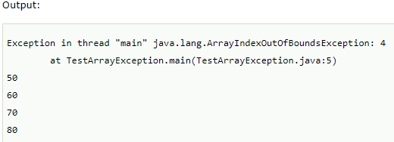
ArrayIndexOutOfBoundsException
JVM throws an ArrayIndexOutOfBoundsException if length of the array in negative, equal to the array size or greater than the array size while traversing the array.
public class TestArrayException{
public static void main(String args[]){
int arr[]={50,60,70,80};
for(int i=0;i<=arr.length;i++){
System.out.println(arr[i]);
}
}}

Slide 9
Example of Multidimensional Java Array
//Java Program to illustrate the use of multidimensional array
class Testarray3{
public static void main(String args[]){
int arr[][]={{1,2,3},{2,4,5},{4,4,5}};
//printing 2D array
for(int i=0;i<3;i++){
for(int j=0;j<3;j++){
System.out.print(arr[i][j]+" ");
}
System.out.println();
}
}}

Slide 10

Jagged Array :odd number of columns in a 2D array,
class TestJaggedArray{
public static void main(String[] args){
//declaring a 2D array with odd columns
int arr[][] = new int[3][];
arr[0] = new int[3];
arr[1] = new int[4];
arr[2] = new int[2];
//initializing a jagged array
int count = 0;
for (int i=0; i<arr.length; i++)
for(int j=0; j<arr[i].length; j++)
arr[i][j] = count++;
//printing the data of a jagged array
for (int i=0; i<arr.length; i++){
for (int j=0; j<arr[i].length; j++){
System.out.print(arr[i][j]+" ");
}
System.out.println();//new line
}
}
}

Slide 11

Addition of 2 Matrices in Java
class Testarray5{
public static void main(String args[]){
//creating two matrices
int a[][]={{1,3,4},{3,4,5}};
int b[][]={{1,3,4},{3,4,5}};
//creating another matrix to store the sum of two matrices
int c[][]=new int[2][3];
//adding and printing addition of 2 matrices
for(int i=0;i<2;i++){
for(int j=0;j<3;j++){
c[i][j]=a[i][j]+b[i][j];
System.out.print(c[i][j]+" ");
}
System.out.println();//new line
}
}}

Slide 12
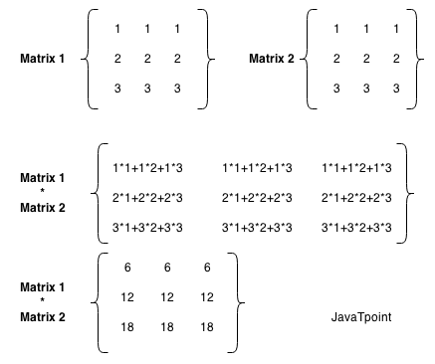
Multiplication of 2 Matrices

Slide 13
public class MatrixMultiplicationExample{
public static void main(String args[]){
int a[][]={{1,1,1},{2,2,2},{3,3,3}};
int b[][]={{1,1,1},{2,2,2},{3,3,3}};
int c[][]=new int[3][3]; //3 rows and 3 columns
//multiplying and printing multiplication of 2 matrices
for(int i=0;i<3;i++){
for(int j=0;j<3;j++){
c[i][j]=0;
for(int k=0;k<3;k++)
{
c[i][j]+=a[i][k]*b[k][j];
}//end of k loop
System.out.print(c[i][j]+" "); //printing matrix element
} //end of j loop
System.out.println();//new line
}
}}

Slide 14
int m, n, c, d;
Scanner in = new Scanner(System.in);
System.out.println("Enter the number of rows and columns of matrix");
m = in.nextInt();
n = in.nextInt();
int first[][] = new int[m][n];
int second[][] = new int[m][n];
int sum[][] = new int[m][n];
System.out.println("Enter the elements of first matrix");
for (c = 0; c < m; c++)
for (d = 0; d < n; d++)
first[c][d] = in.nextInt();
System.out.println("Enter the elements of second matrix");
for (c = 0 ; c < m; c++)
for (d = 0 ; d < n; d++)
second[c][d] = in.nextInt();
for (c = 0; c < m; c++)
for (d = 0; d < n; d++)
sum[c][d] = first[c][d] + second[c][d]; //replace '+' with '-' to subtract matrices
System.out.println("Sum of the matrices:");
for (c = 0; c < m; c++)
{
for (d = 0; d < n; d++)
System.out.print(sum[c][d] + "\t");
System.out.println();
}
ADDITION OF TWO MATRIX

Slide 15
int m, n, p, q, sum = 0, c, d, k;
Scanner in = new Scanner(System.in);
System.out.println("Enter the number of rows and columns of first matrix");
m = in.nextInt();
n = in.nextInt();
int first[][] = new int[m][n];
System.out.println("Enter elements of first matrix");
for (c = 0; c < m; c++)
for (d = 0; d < n; d++)
first[c][d] = in.nextInt();
System.out.println("Enter the number of rows and columns of second matrix");
p = in.nextInt();
q = in.nextInt();
if (n != p)
System.out.println("The matrices can't be multiplied with each other.");
else
{
int second[][] = new int[p][q];
int multiply[][] = new int[m][q];
System.out.println("Enter elements of second matrix");
for (c = 0; c < p; c++)
for (d = 0; d < q; d++)
second[c][d] = in.nextInt();
for (c = 0; c < m; c++) {
for (d = 0; d < q; d++) {
for (k = 0; k < p; k++)
sum = sum + first[c][k]*second[k][d];
multiply[c][d] = sum;
sum = 0;
}
MULTIPLICATION OF TWO MATRIX

